Slide 1
DPZ Meeting

Slide 2
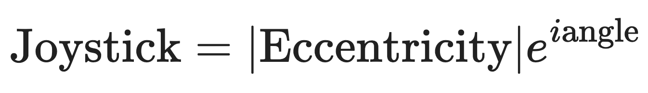
What’s new ?
Complex notation (I added the eccentricity):
Kernel profile for each agent (one kernel per coherence)
divided the data into training set and test set for each agent and per coherence
Averaged kernels over agents
Lasso regularisation of the kernels

Slide 3
Previously
Kernel profile for each agent (one kernel per coherence)
divided the data into training set and test set for each agent and per coherence

Slide 4
What’s new ?
Smoother Kernels
Extracting the Kernel profile for each agent from the dyadic data (one kernel per coherence)
Fitting the Kernels with a piecewise exponential model

Slide 5
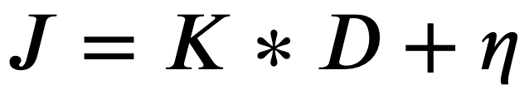
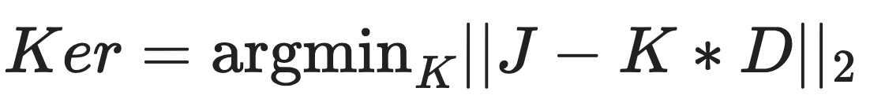
Basic kernel

Slide 6
Smoothing the Kernels
Linear interpolation of the data
time frames of the dot position and time frame of the joystick data don’t match due to different sampling times
Linear extrapolation of the joystick data to the timeframes of the dot positions

Slide 7
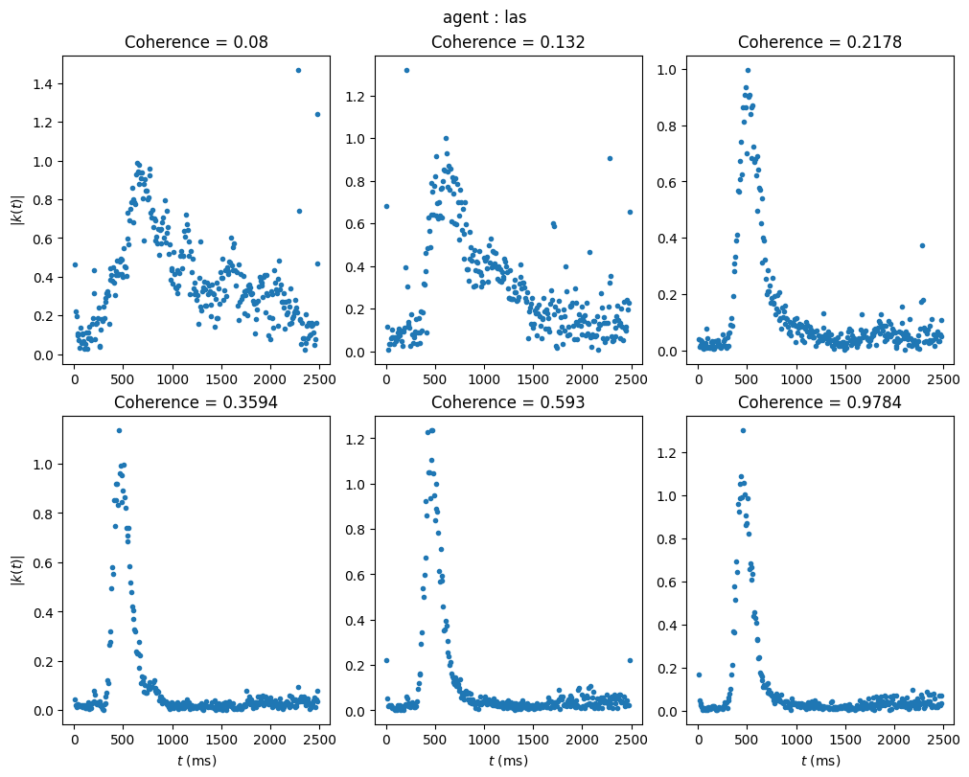
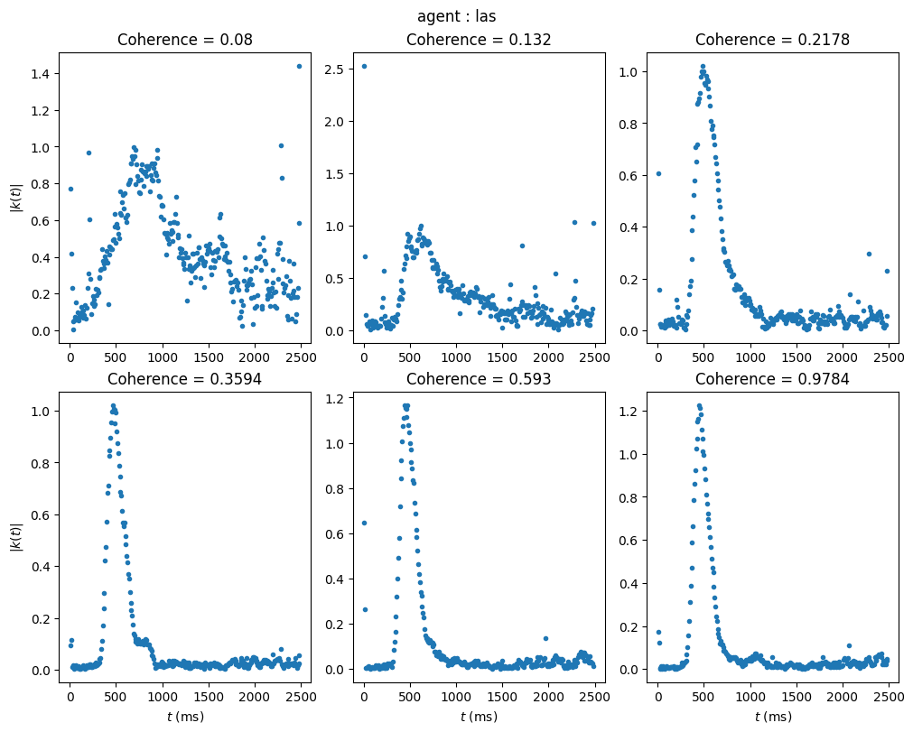
Kernel Profile of solo agent
After linear interpolation
Before
After

Slide 8
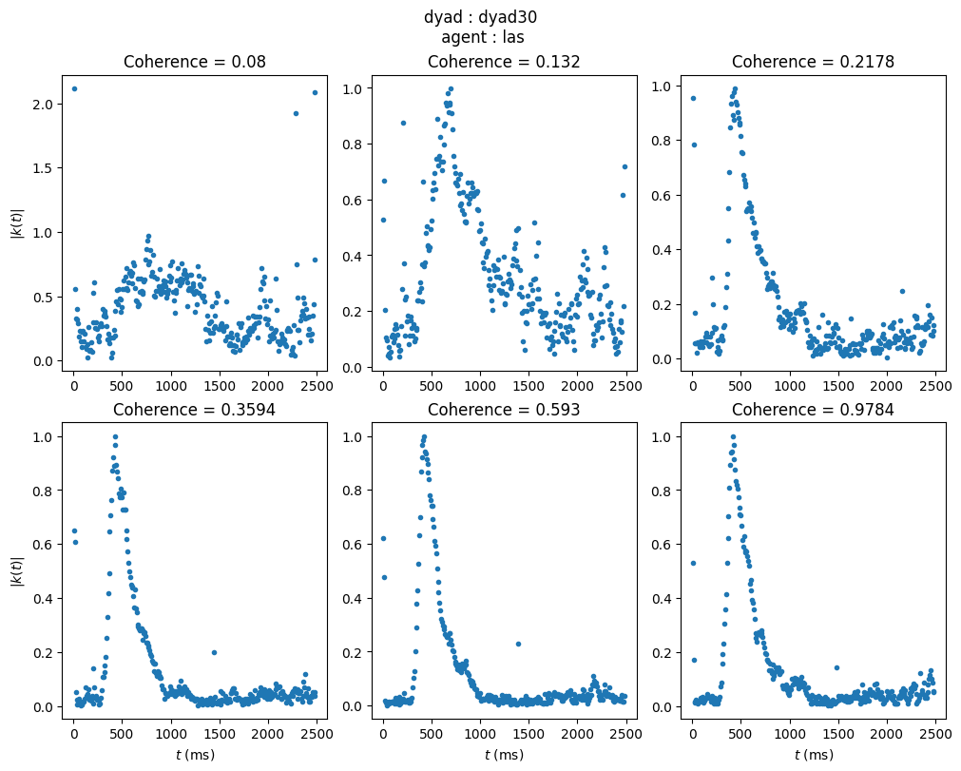
Kernel Profile of one agent in dyad

Slide 9
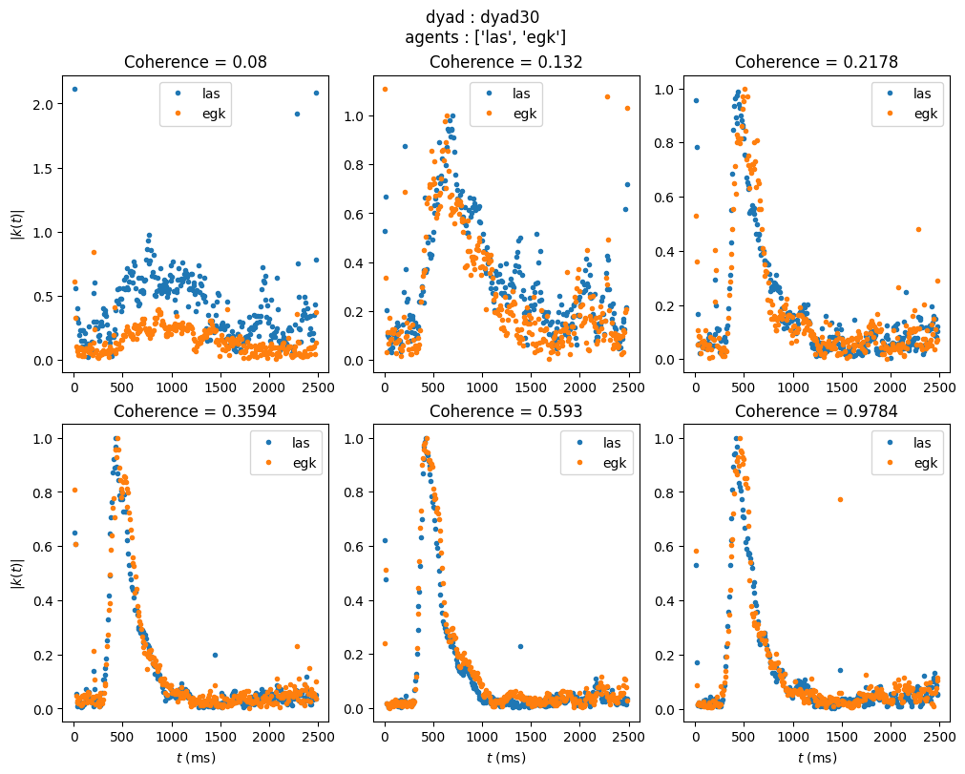
Kernel Profile of both agents in dyad

Slide 10
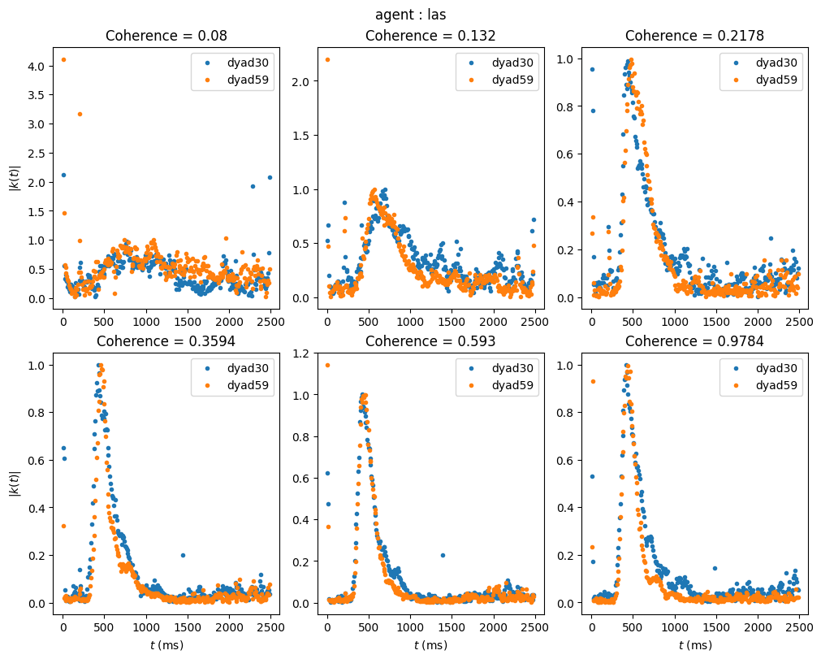
Fitted Kernel Profile of one agent in multiple dyads

Slide 11
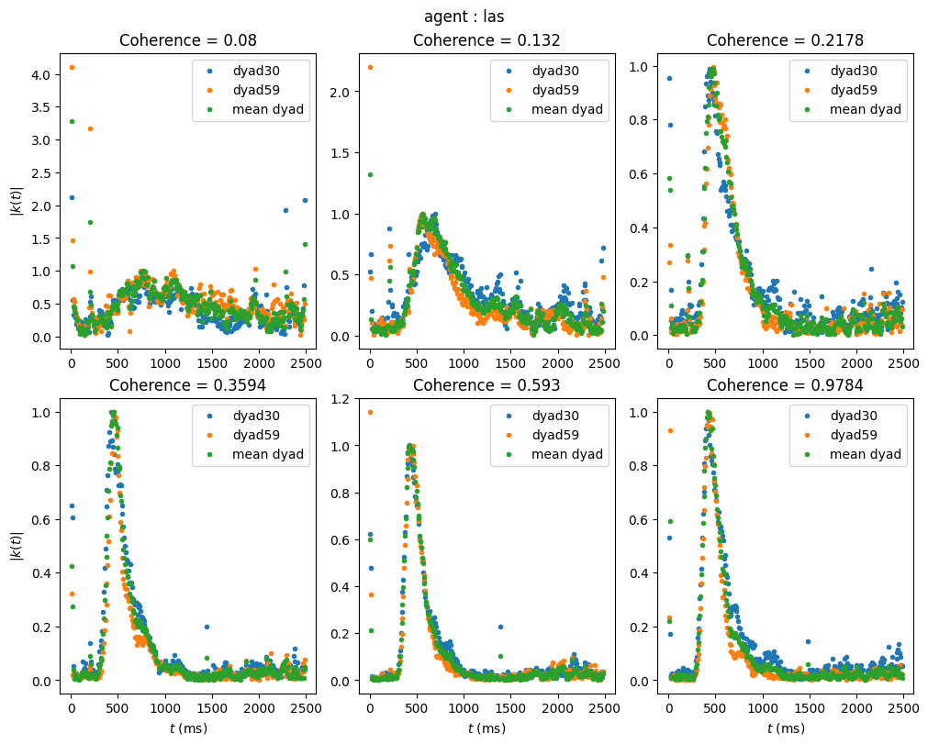
Fitted Kernel Profile of one agent in dyads vs mean
Notes:
Mean kernel of dyad

Slide 12
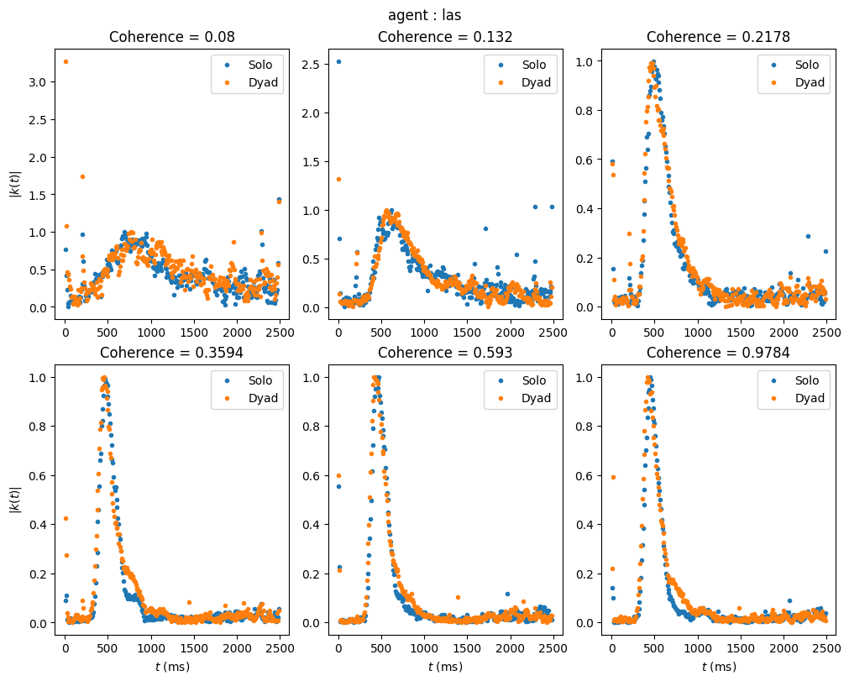
Kernel Profile of one agent in dyad vs solo
Notes:
Mean kernel of dyad

Slide 13
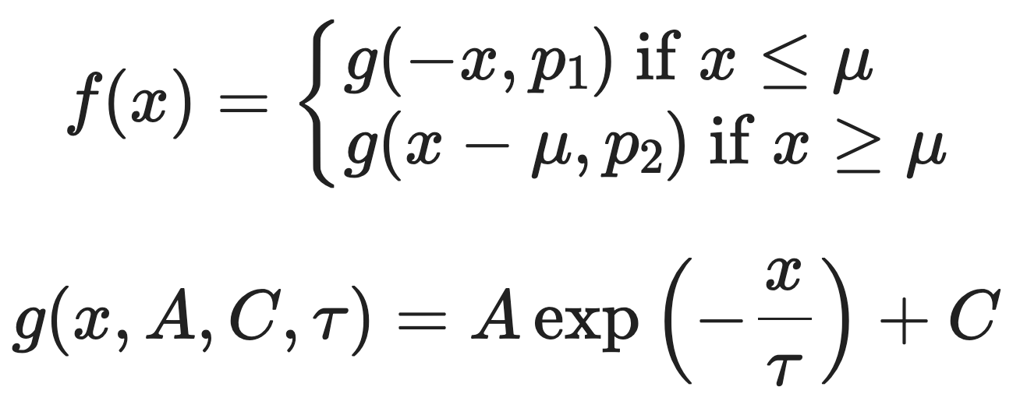
Fitting the Kernels with:
piecewise exponential model
mu
tau2
tau1
mu : Reaction time
tau1 : first convergence time
tau2 : second convergence time

Slide 14
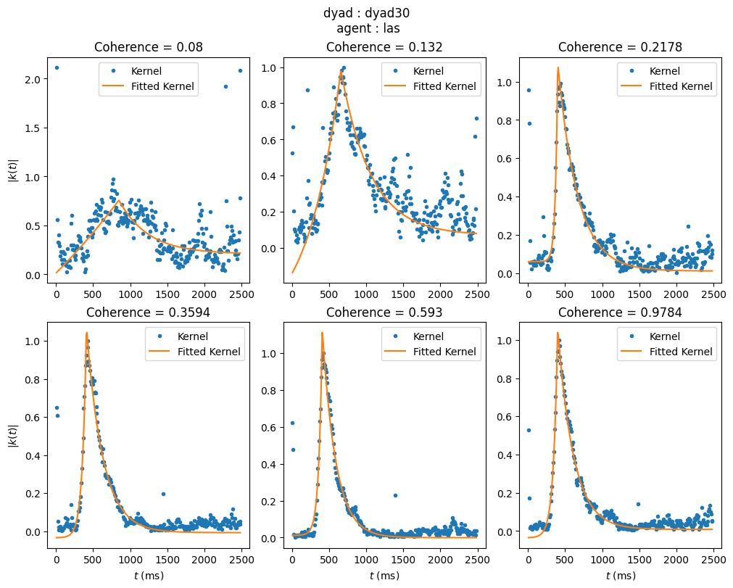
Fitted Kernel Profile of one agent in dyad

Slide 15
What are the questions ?
is there a difference in parameters between solo and dyad? is it bigger than for the same agent in multiple dyads ?
is the difference in parameters between two agents in the same dyad bigger than the difference in parameters of one agent in multiple dyads ?
What is the distribution of parameters ? are they related to each other ?
Are the parameters distributed differently in solo vs dyadic ?

Slide 16
is there a difference in parameters between solo and dyad?

Slide 17
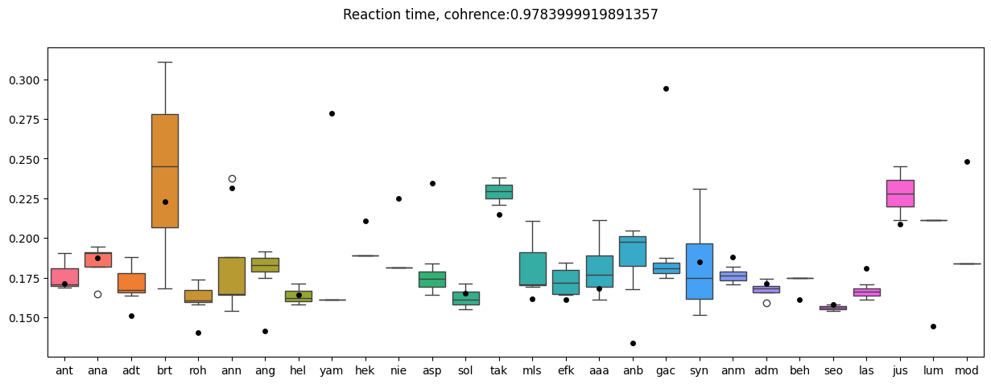
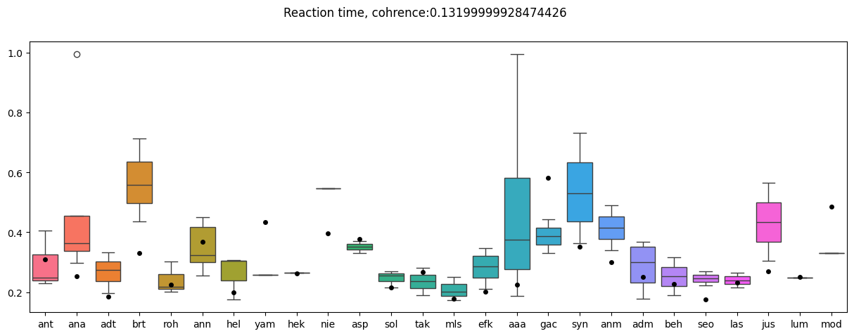
Mu

Slide 18
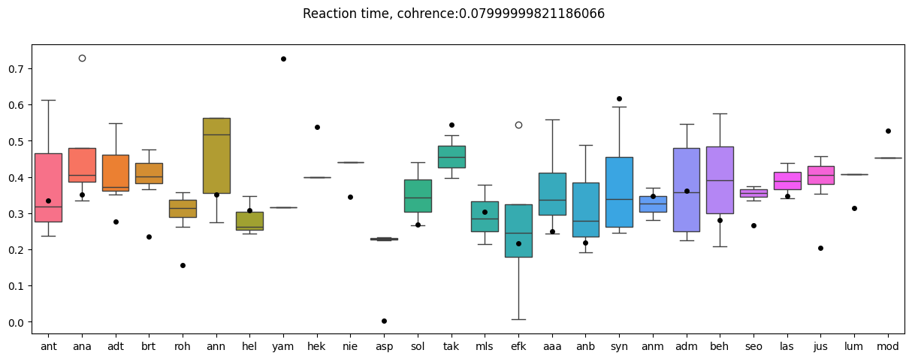

Slide 19
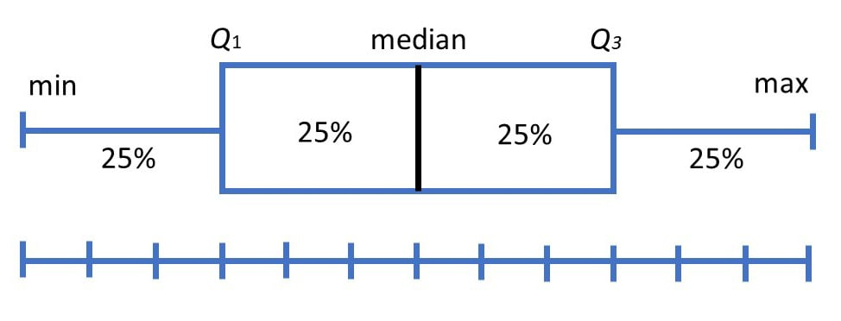

Slide 20
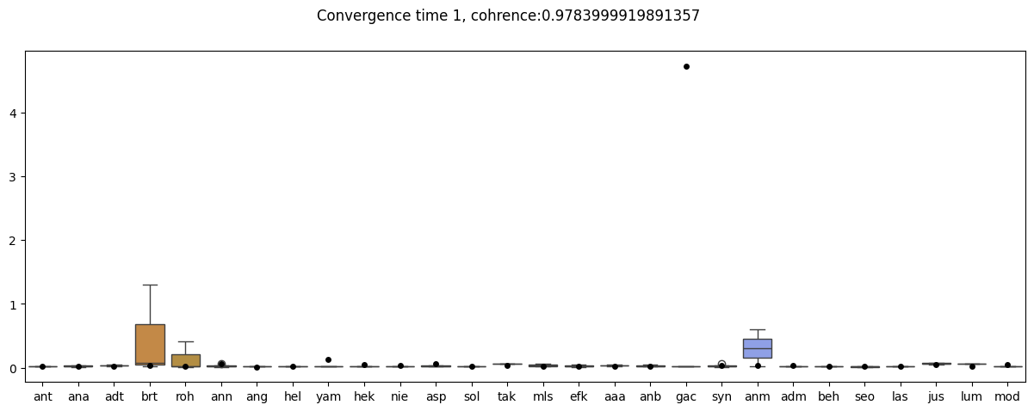
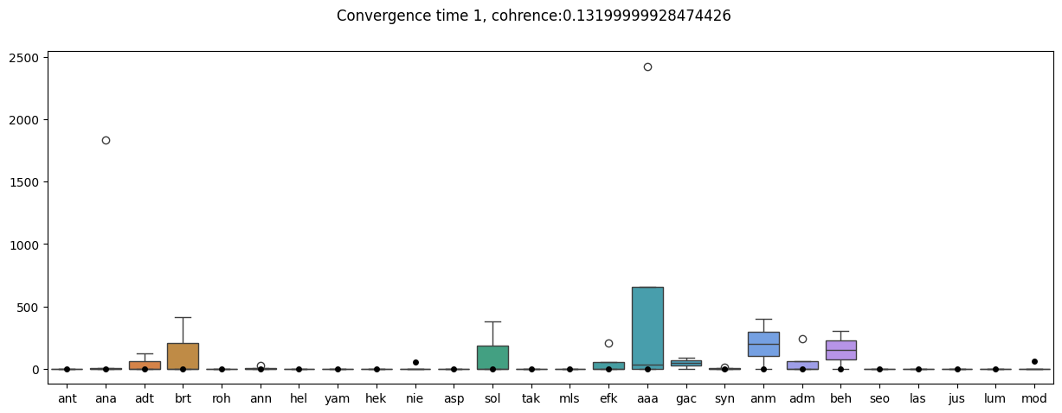
Tau1

Slide 21
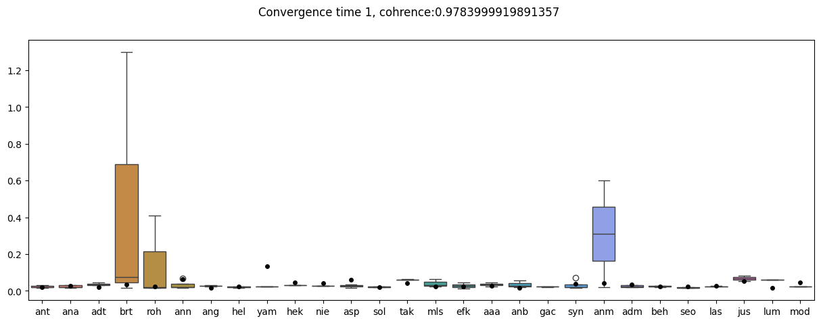
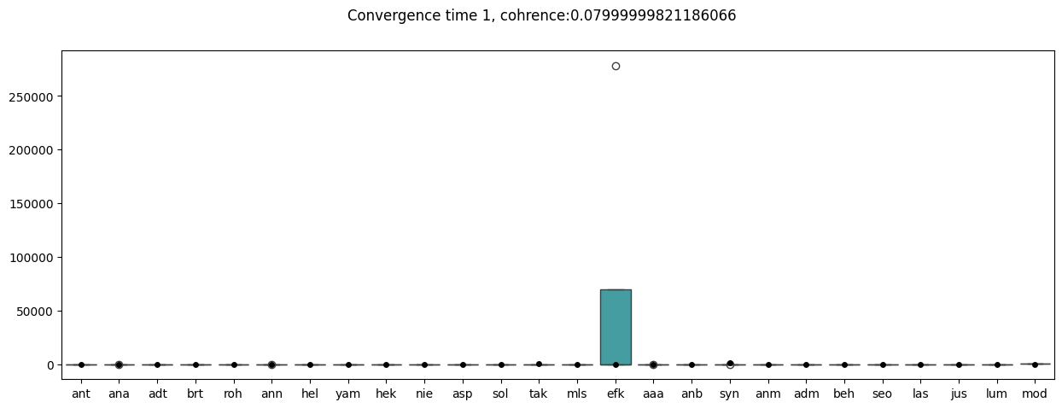

Slide 22
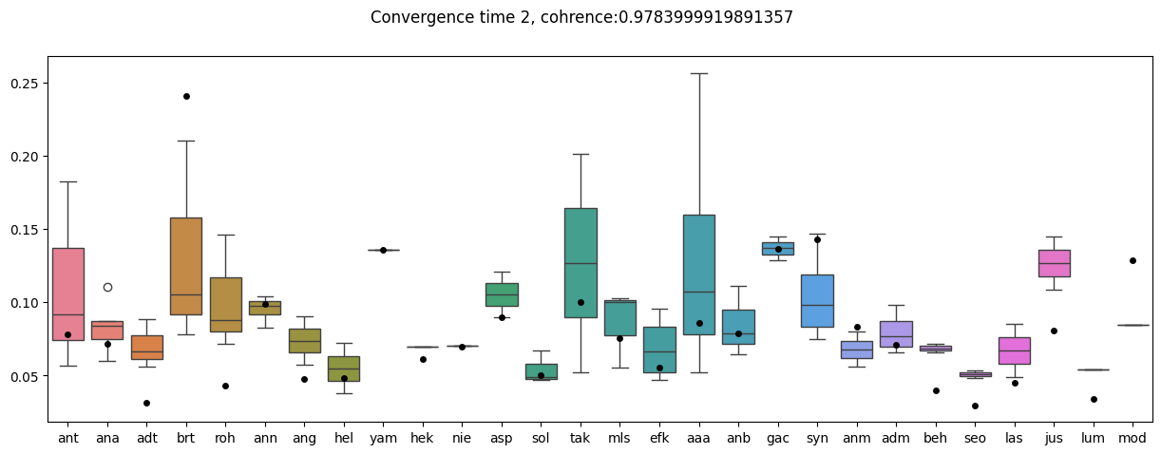
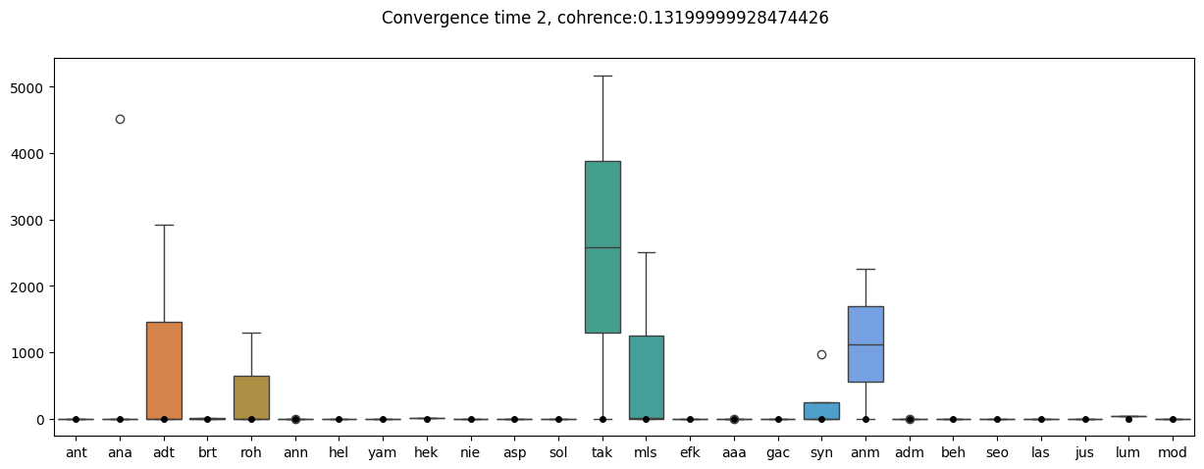
Tau2

Slide 23
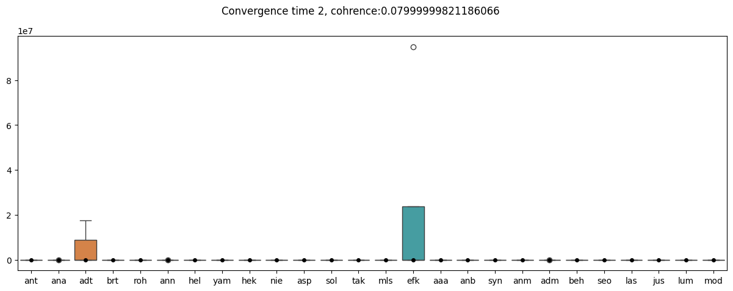

Slide 24
What is the distribution of parameters ? are they related to each other ?

Slide 25
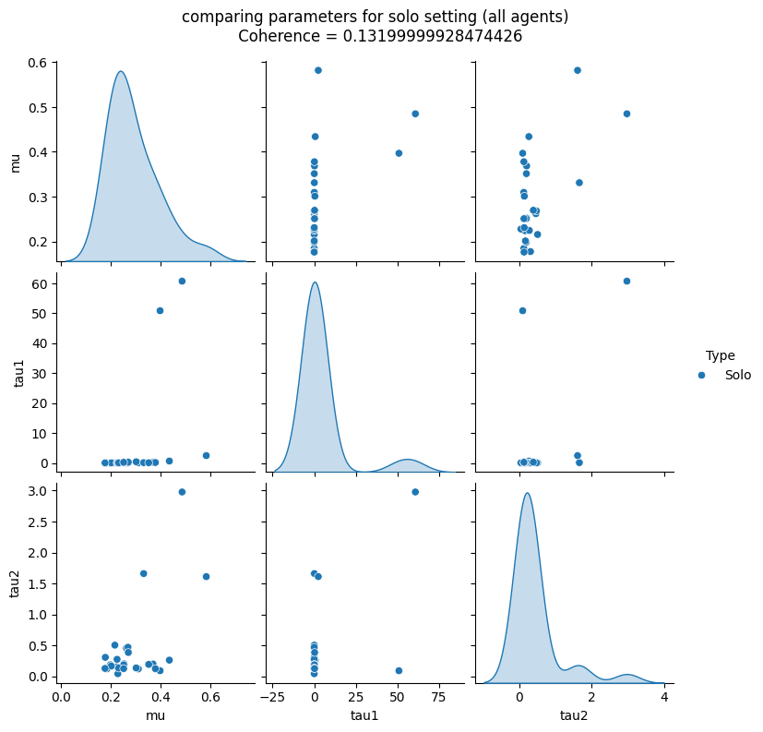
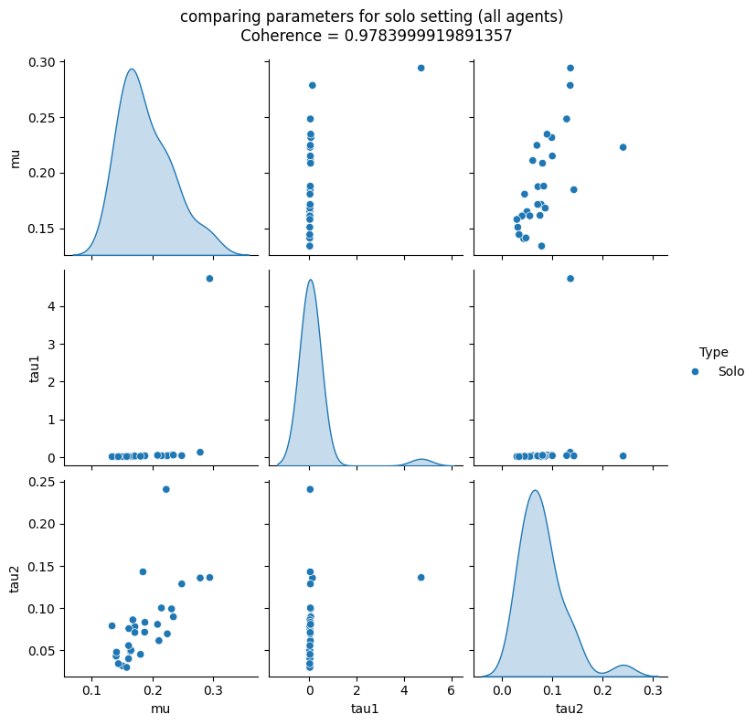
Solo

Slide 26
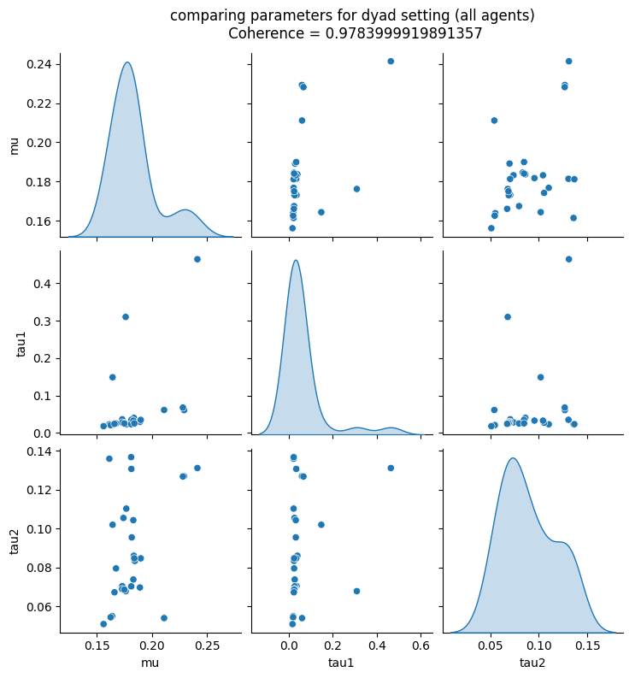
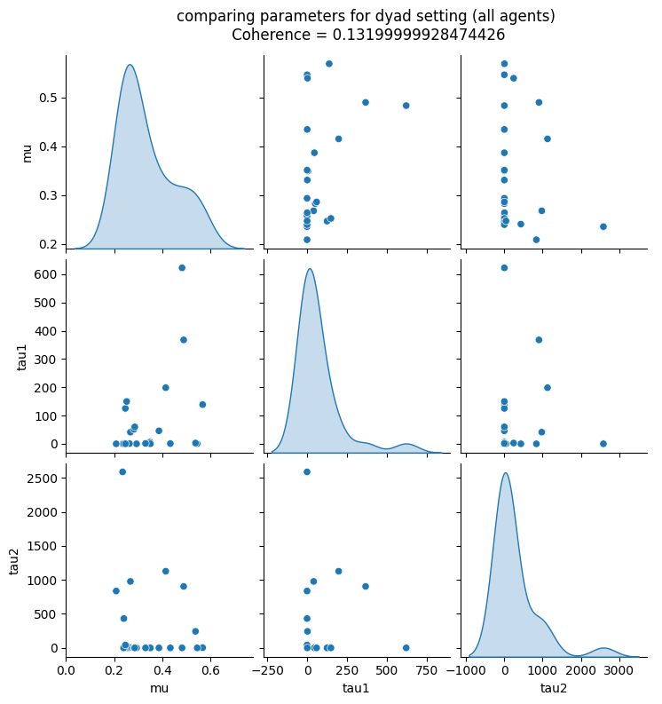
Dyad

Slide 27
Are the parameters distributed differently in solo vs dyadic ?

Slide 28
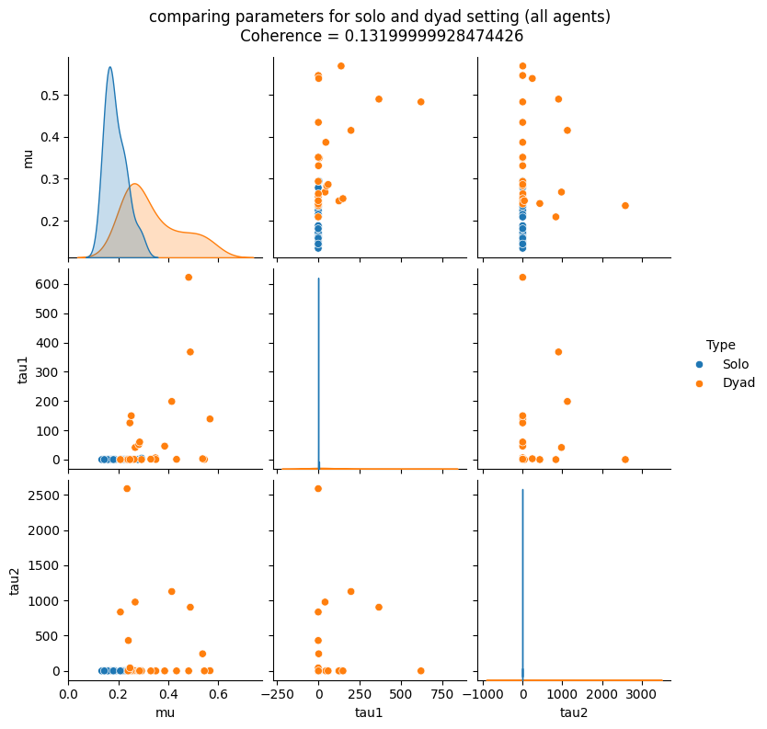
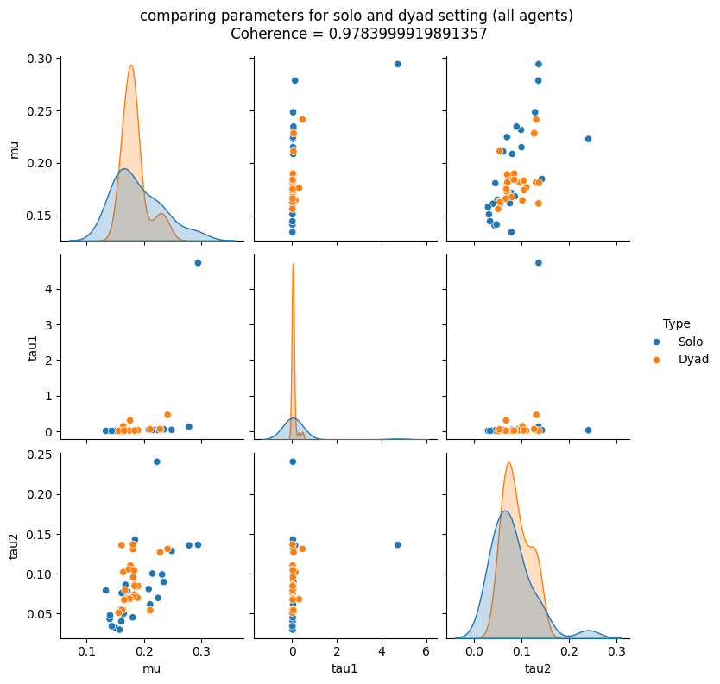
Dyad and Solo

Slide 29
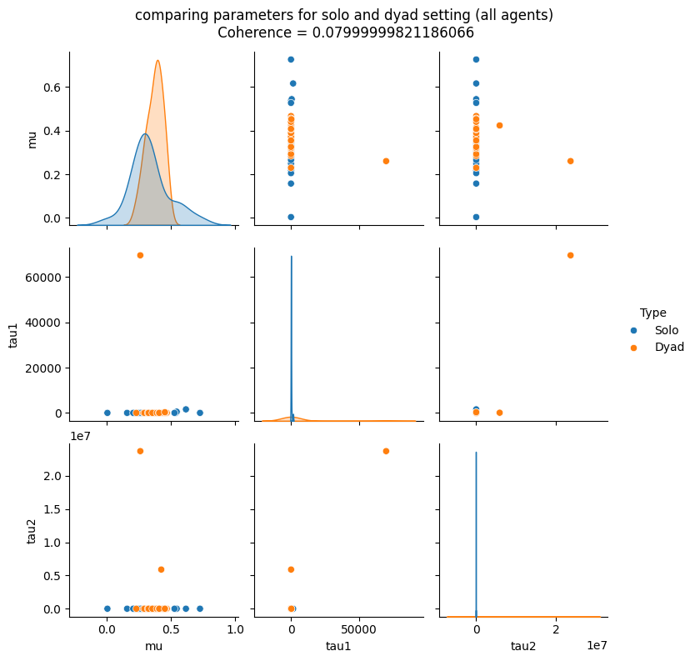

Slide 30
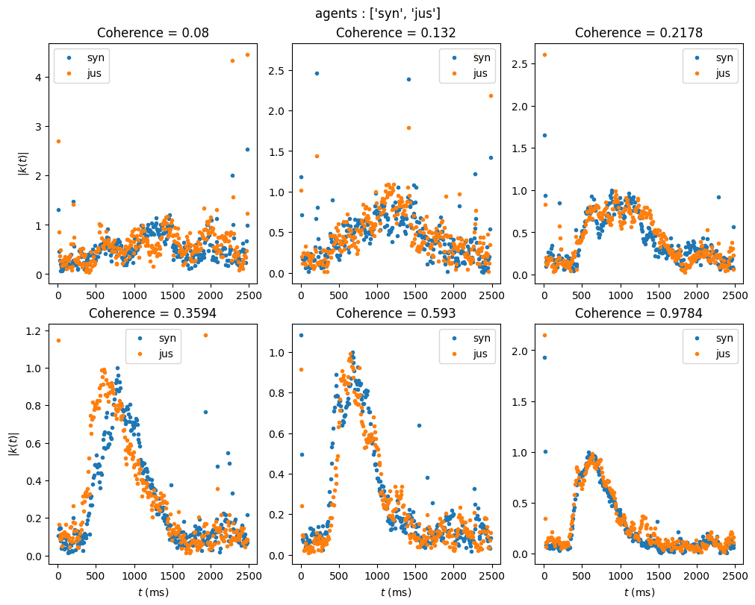
Kernel Profile of both agents in dyad

Slide 31
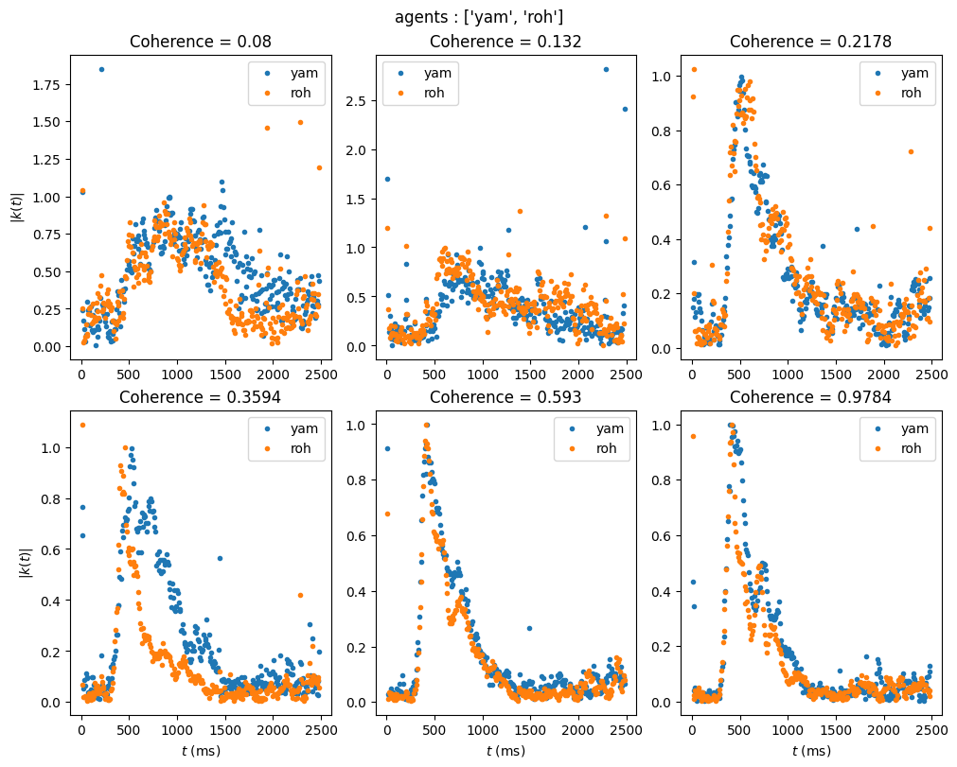
Kernel Profile of both agents in dyad

Slide 32
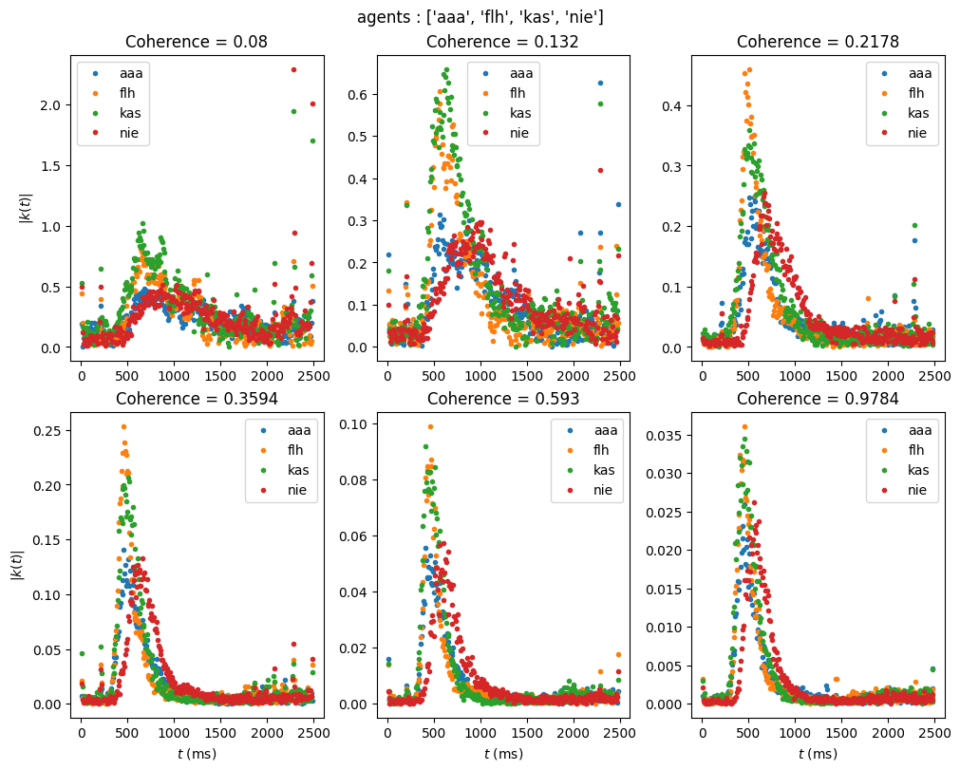
Kernel profile for 4 agents

